Slide 1
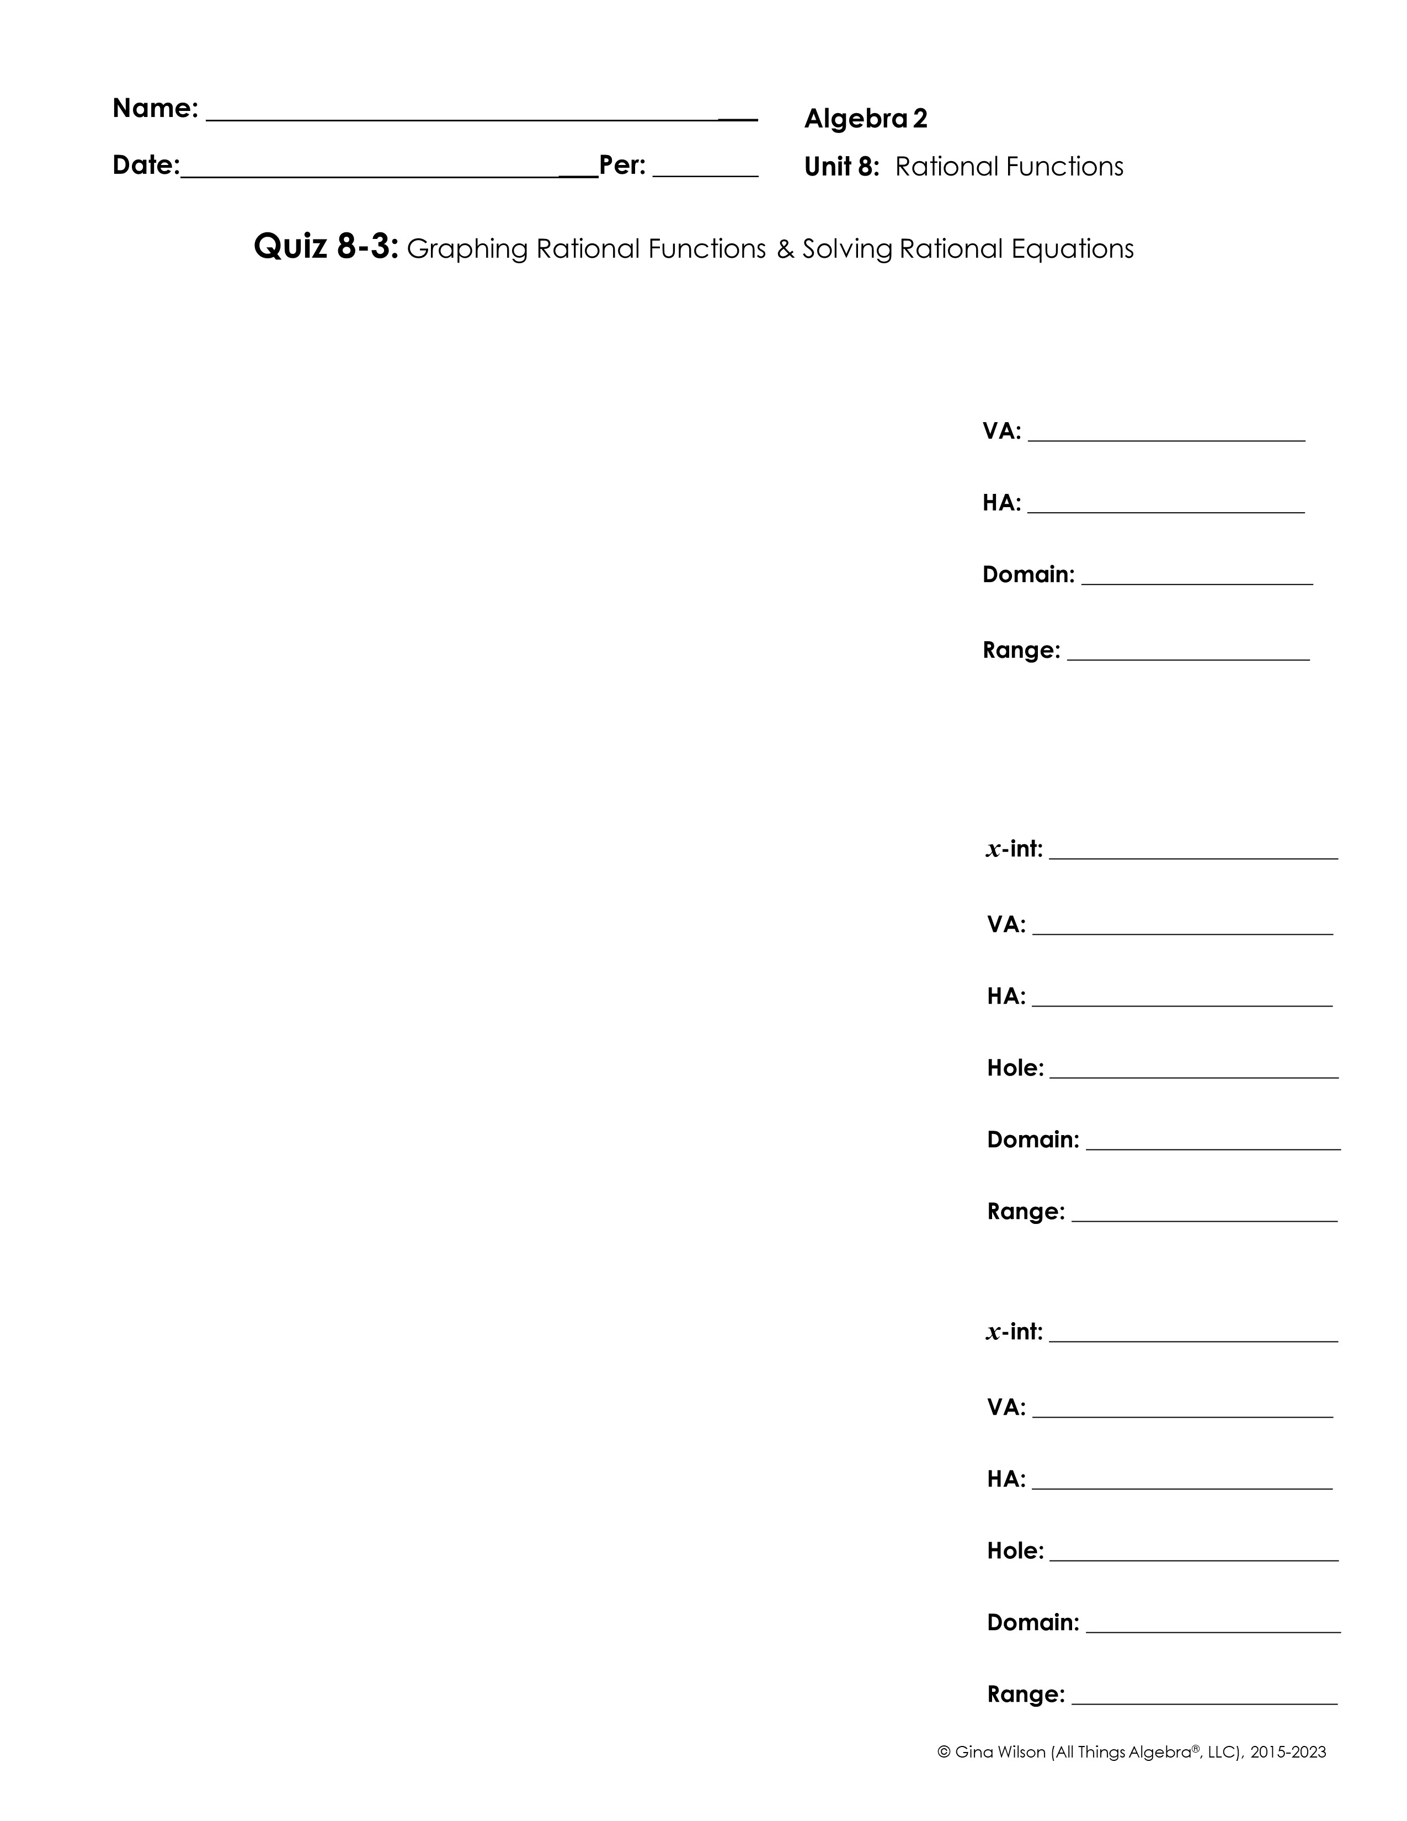
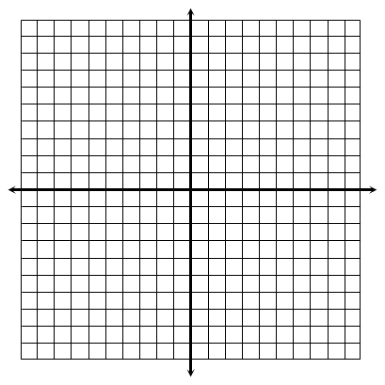
Part I: Graphing – Graph each function and identify its key characteristics.
1.
2.
3.

Slide 2

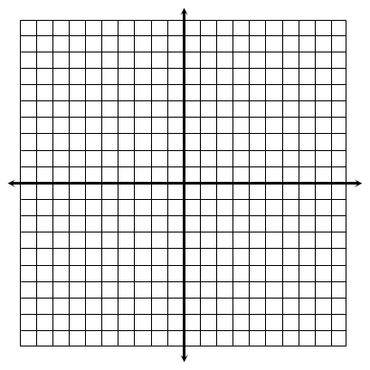
4.
5.
Part II: Equations – Solve each equation. Be sure to check all solutions.
6.
7.
8.
9.

